Slide 1
Michael Tran
8/7/19 Updates

Slide 2
Michael Tran
8/7/19 Updates
FINISHED DATA ENTRY!! (444 records in database)

Slide 3
Michael Tran
8/7/19 Updates
FINISHED DATA ENTRY!! (444 records in database)
Updated website with new colors and information

Slide 4


Slide 5
Michael Tran
8/7/19 Updates
FINISHED DATA ENTRY!! (444 records in database)
Updated website with new colors and information

Slide 6
Michael Tran
8/7/19 Updates
FINISHED DATA ENTRY!! (444 records in database)
Updated website with new colors and information
Choropleth map in R

Slide 7
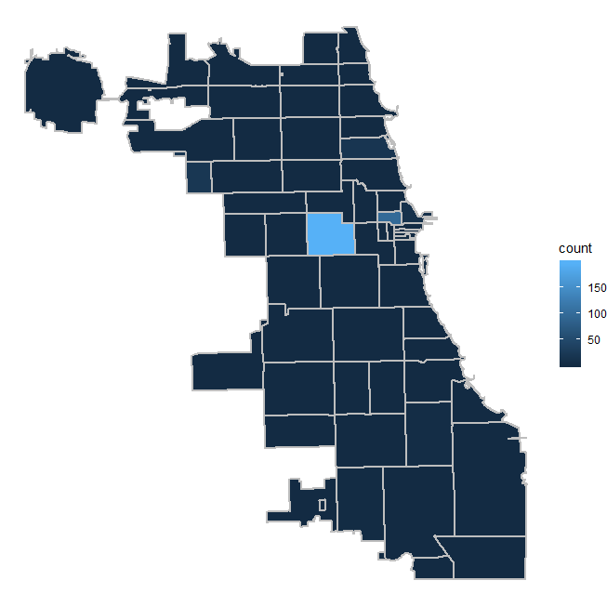
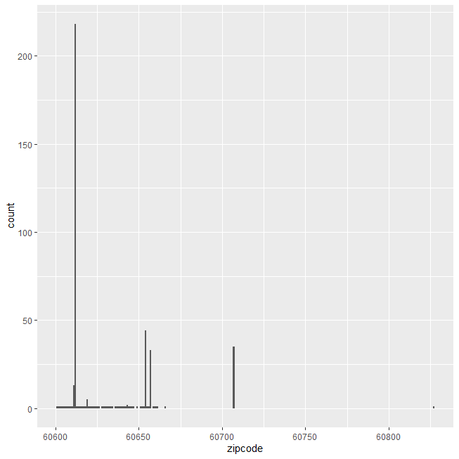

Slide 8
Michael Tran
8/7/19 Updates
FINISHED DATA ENTRY!! (444 records in database)
Updated website with new colors and information
Choropleth map in R

Slide 9
Michael Tran
8/7/19 Updates
FINISHED DATA ENTRY!! (444 records in database)
Updated website with new colors and information
Choropleth map
Going over the database again for additional information

Slide 10
Michael Tran
8/7/19 Updates
FINISHED DATA ENTRY!! (444 records in database)
Updated website with new colors and information
Choropleth map
Going over the database again for additional information
Last week of internship

